Slide 1

Bankruptcy-Prediction-project
"Using Machine Learning to Predict Bankruptcy Risk: A Case Study"

Slide 2

TEAM MEMBERS
N.ASHWIN SIDDHARTHA
N.NARENDRA
M. GANESH
VEMULA JAGADISH
SHIVANI GUTTIPRATIWAR
PRAKASH VAISHNAV

Slide 3
Project Flow / architecture
Understanding Business Objective
Deployment Using Streamlit
Exploratory Data Analysis – EDA
Train Test Split
Model Buliding
Model Evaluation

Slide 4
Business Objective:
This is a classification project, since the variable to predict is binary (bankruptcy or non-bankruptcy). The goal here is to model the probability that a business goes
bankrupt from different features. The data file contains 7 features about 250 companies The data set includes the following variables:
Industrial risk: 0=low risk, 0.5=medium risk, 1=high risk.
Management risk: 0=low risk, 0.5=medium risk, 1=high risk.
financial flexibility: 0=low flexibility, 0.5=medium flexibility, 1=high flexibility.
credibility: 0=low credibility, 0.5=medium credibility, 1=high credibility.
competitiveness: 0=low competitiveness, 0.5=medium competitiveness, 1=high competitiveness.
Operating risk: 0=low risk, 0.5=medium risk, 1=high risk.
class: bankruptcy, non-bankruptcy (target variable).

Slide 5
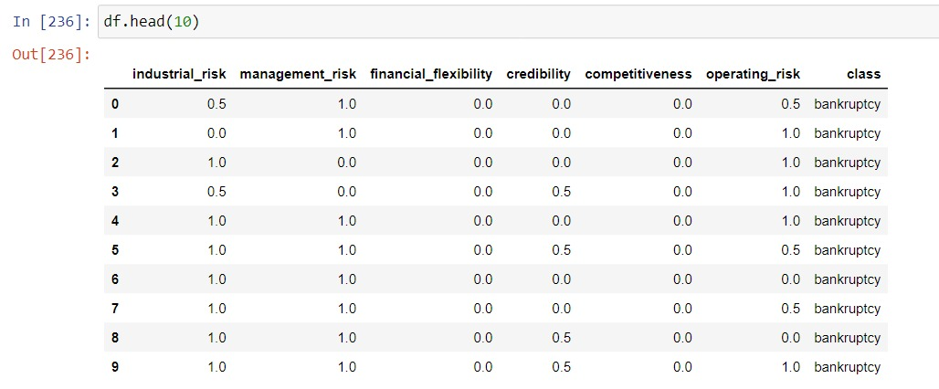
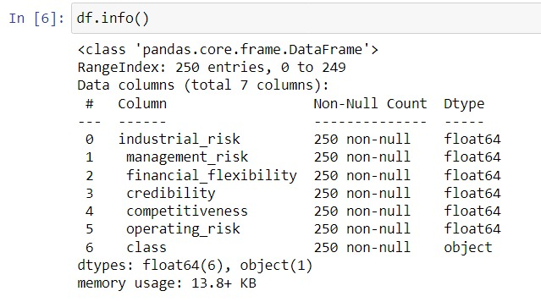
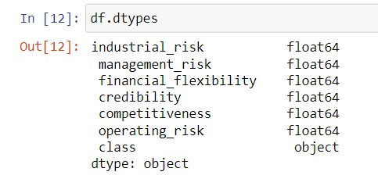
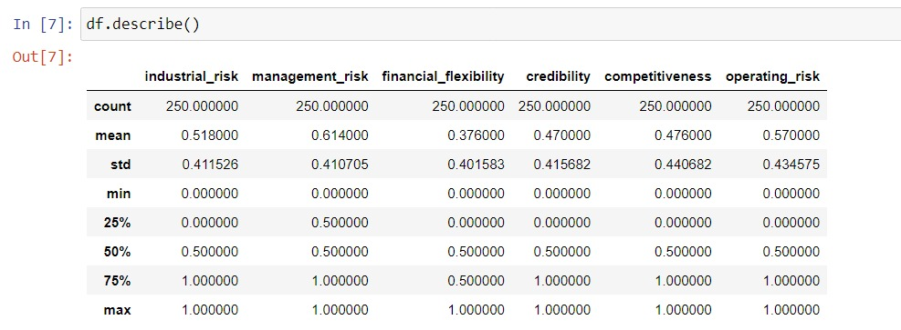
Exploratory Data Analysis - EDA

Slide 6
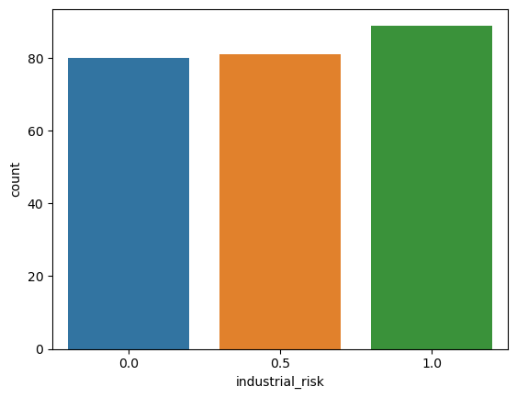
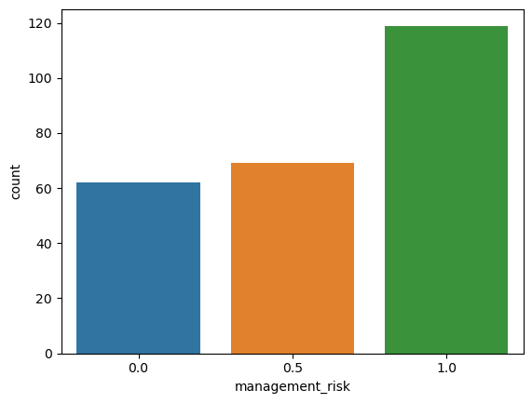
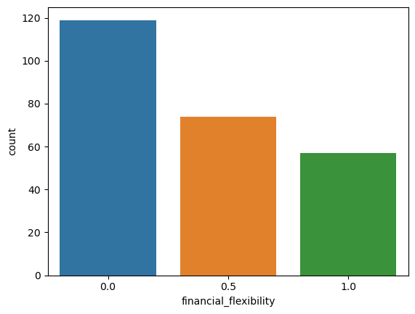
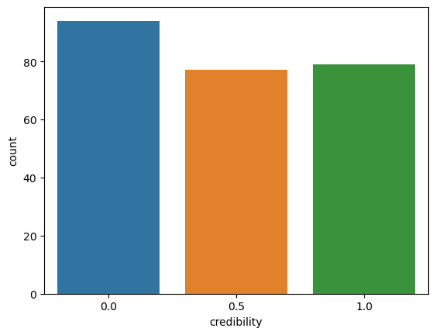
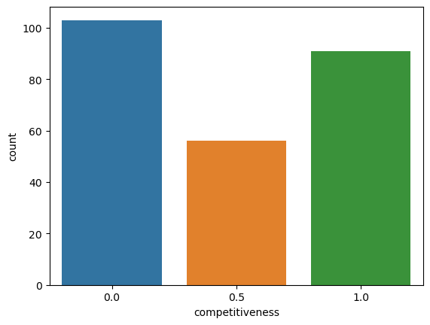
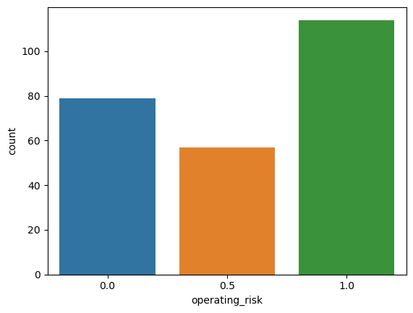

Slide 7
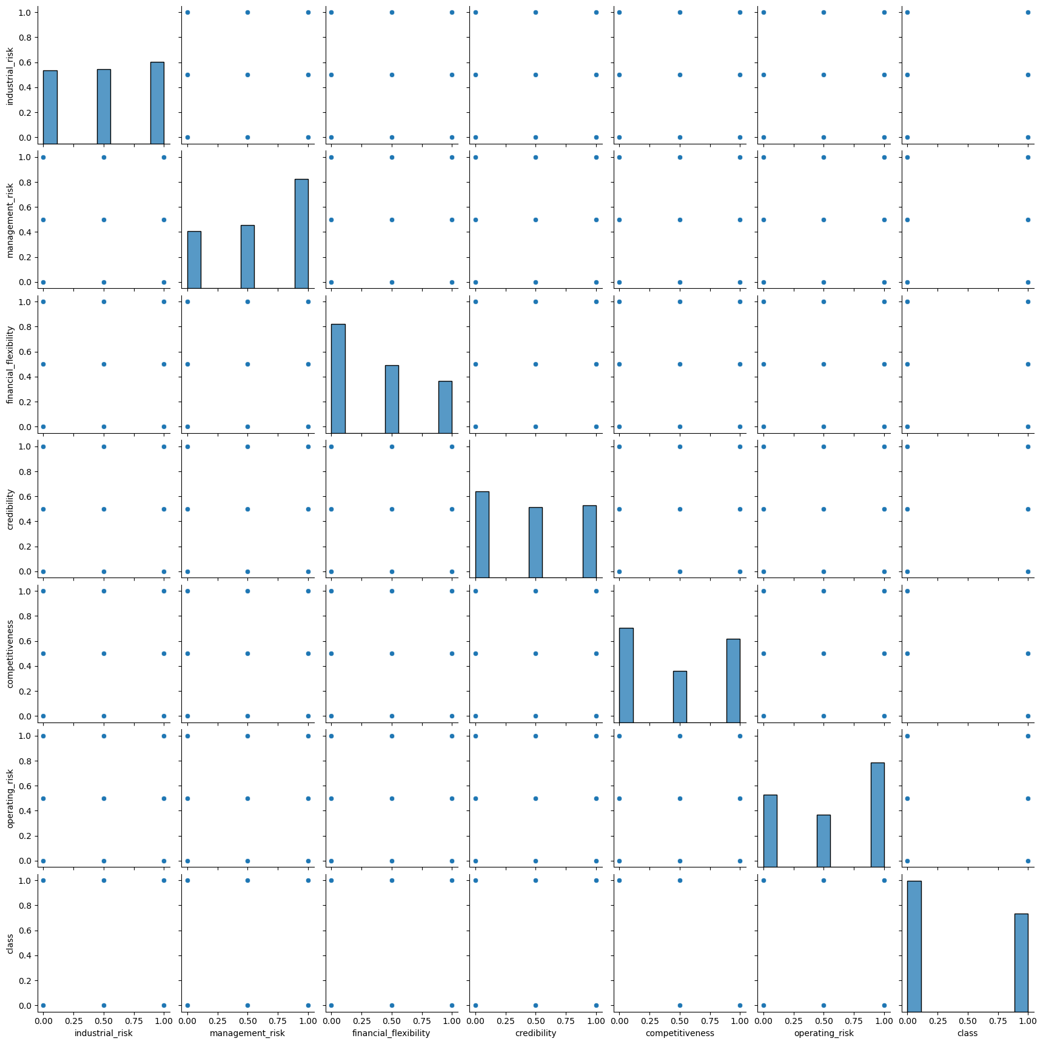
Pair Plotting

Slide 8
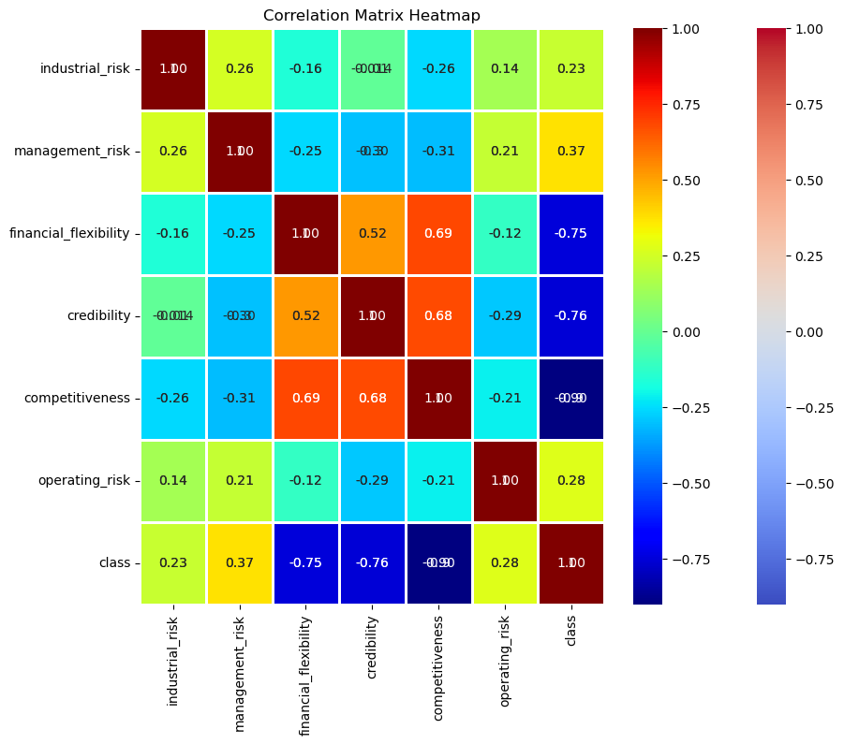

Slide 9
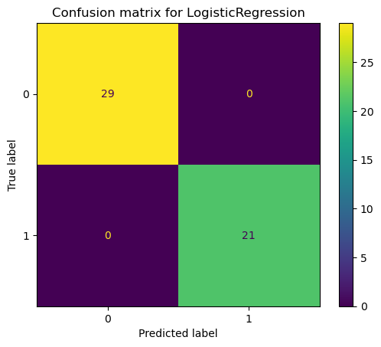
Logistic regression model :
Class | Precision | Recall | F1-Score | Support
0 | 1.00 | 1.00 | 1.00 | 29

Slide 10
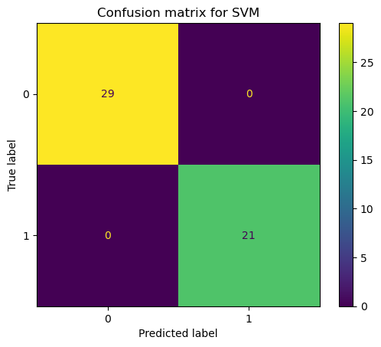
S-v-m model :
precision | recall | f1-score | support
0 | 1.00 | 1.00 | 1.00 | 29
1 | 1.00 | 1.00 | 1.00 | 21
accuracy |  |  | 1.00 | 50
macro avg | 1.00 | 1.00 | 1.00 | 50
weighted avg | 1.00 | 1.00 | 1.00 | 50

Slide 11
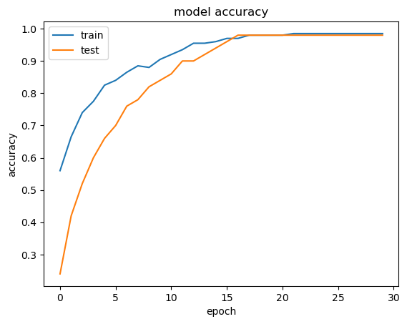
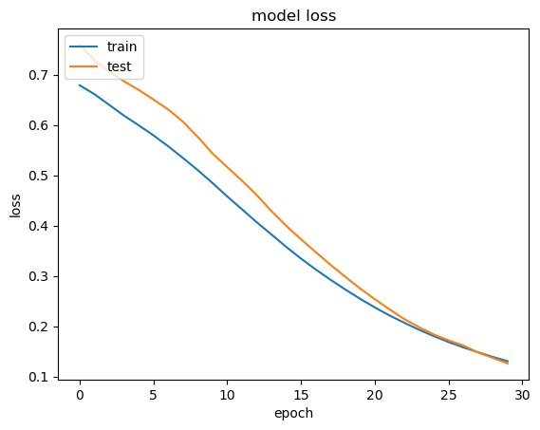
ANN model :
Dataset | Loss | Accuracy
Train | 0.1242 | 0.9900
Test | 0.1315 | 0.9600

Slide 12

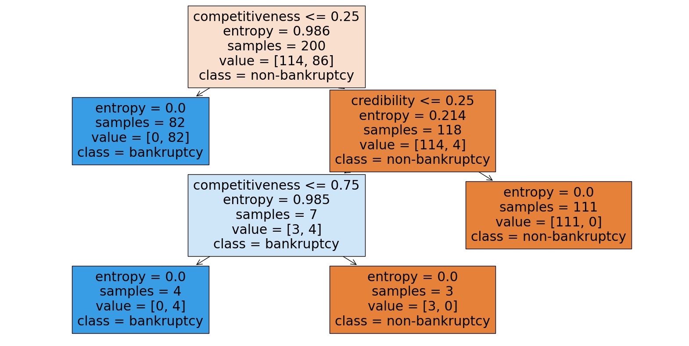
Decision tree model :
Class | Precision | Recall | F1-Score | Support
0 | 1.00 | 0.97 | 0.98 | 29

Slide 13

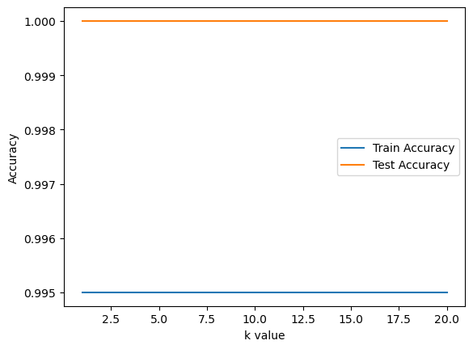
K n n model :
Class | Precision | Recall | F1-Score | Support
0 | 1.00 | 1.00 | 1.00 | 29

Slide 14
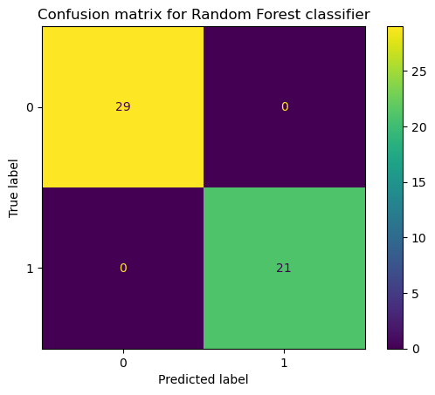
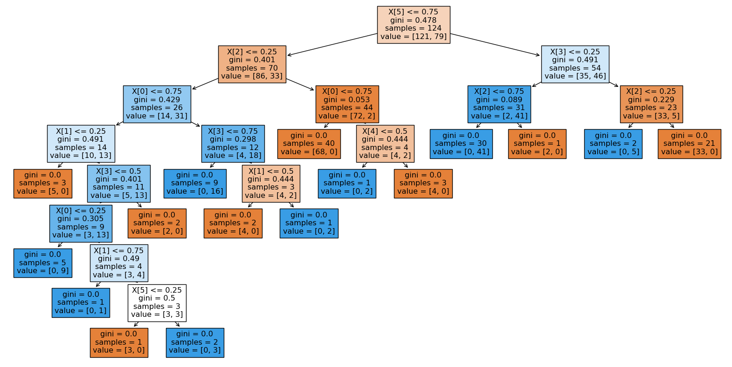
Random forest model :
Class | Precision | Recall | F1-Score | Support
0 | 1.00 | 1.00 | 1.00 | 29

Slide 15
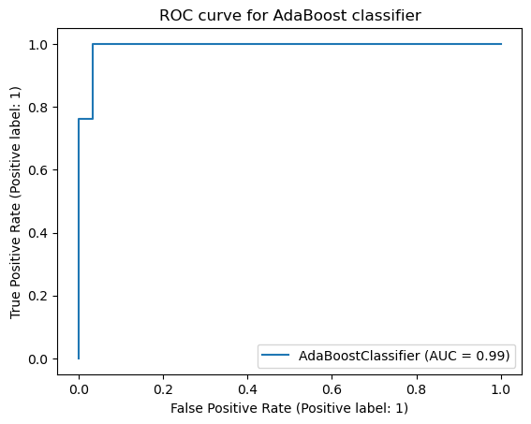

Adaboost classifier :
Metric | Precision | Recall | F1-Score | Support
0 | 1.00 | 0.97 | 0.98 | 29
1 | 0.95 | 1.00 | 0.98 | 21
Accuracy |  |  | 0.98 | 50
Macro Avg | 0.98 | 0.98 | 0.98 | 50
Weighted Avg | 0.98 | 0.98 | 0.98 | 50

Slide 16

Xg-boost model :
 | precision | recall | f1-score | support
 | 1.00 | 0.97 | 0.98 | 29

Slide 17
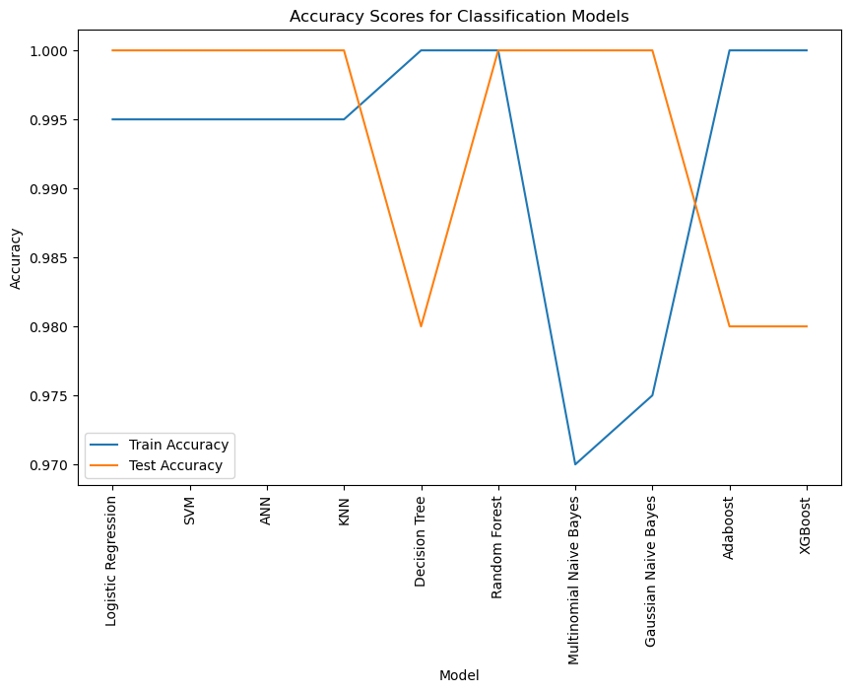
Accuracy’s scores of all classification models :

Slide 18
Model training and test accuracy:
Model | Train Accuracy | Test Accuracy
Logistic Regression | 0.995 | 1
SVM | 0.995 | 1
ANN | 0.995 | 0.96
KNN | 0.995 | 1
Decision Tree | 1 | 0.98
Random Forest | 1 | 1
Multinomial Naive Bayes | 0.97 | 1
Gaussian Naive Bayes | 0.975 | 1
Adaboost | 1 | 0.98
XGBoost | 1 | 0.98

Slide 19
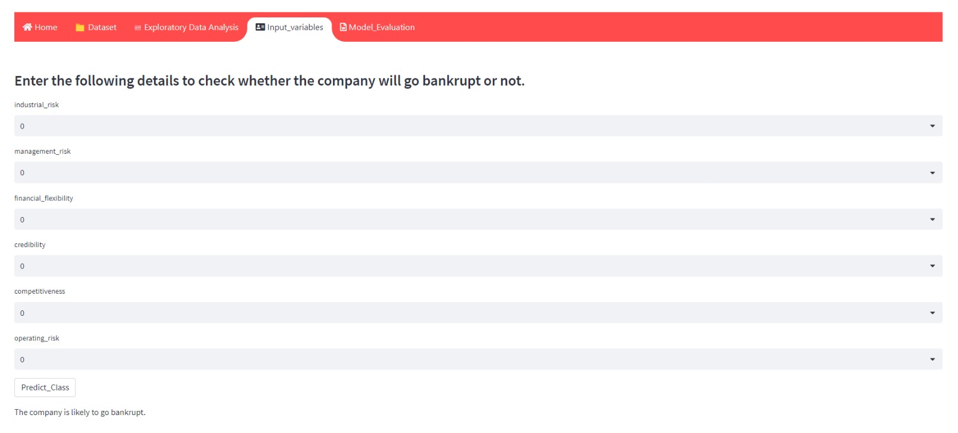
Stream-lit interface of our model:

